Slide 1


VJTI
Veermata Jijabai Technological Institute
H. R. Mahajani Marg, Matunga, Mumbai 400019
www.vjti.ac.in
Centre of Excellence (CoE) in
Complex & Nonlinear Dynamical Systems (CNDS)
VJTI, Matunga, Mumbai-400019
Threat Intelligence
Rahul Rade Department of Electrical Engineering, Veermata Jijabai Technological Institute rsrade_b15@el.vjti.ac.in | Soham Deshmukh Department of Electrical Engineering, Veermata Jijabai Technological Institute ssdeshmukh_b15@el.vjti.ac.in
Ruturaj Nene Department of Electrical Engg. VJTI | Ajay Unny Department of Electrical Engg. VJTI

Slide 2
Project Outline
Phase 1:
Topic introduction and Problem Formulation
Relevant work
Data Collection
Preprocessing and Modelling
Markov Chain (MC)
Hidden Markov Model (HMM)
Long Short Term Memory (LSTM)
Results and comparison
Springer CCIS publication

Slide 3
Phase 2:
Necessity of Big Data System
Kafka System
Producer
Streamer & Flask Server
Consumer
Phase 3:
System Architecture and Data Flow
Models and Kafka System integration
User Interface
Future Work

Slide 4
1.1 - Cyber Attacks
“In warfare, information is power. The better you understand your enemy, the more able you are to defeat him”
In order to defeat attackers, security professionals need to learn and understand the attacker’s methods, tactics, motivation and tools.
Although information technology (IT) systems provide a rich set of functionalities, they are also susceptible to a more challenging set of threats each unique to the attacker.

Slide 5
(cont) Predictive Threat Intelligence
Predictive Threat Intelligence is one of the emerging focus of information security. In short, Predictive Threat Intelligence is based on understanding attacker behaviour and attack pattern to better predict his/her future actions. The foresight of attackers next actions, intentions and targets can help industries and organizations to take better precautionary decisions beforehand. Moreover, the foresight can expose major vulnerabilities or leaks in the existing system. This will help the industries and organizations fix unauthorized access points in their system before they can be used for intrusion.

Slide 6
1.2 - Relevant Work
A lot of efforts are put in understanding the user interaction with the system and finding underlying pattern.
A lot of previous work has been focused on classifying web sessions into “attack” and “normal” classes with the help of Intrusion Detection System (IDS) wherein these web sessions were usually modelled using supervised machine learning algorithms that were used to distinguish sessions
Previous works have also focused on the analysis of polymorphic worms.

Slide 7
(cont) Problems in Existing Methods
These methods are necessary they do not provide better understanding of the nature of existing and future threats.
Having the ability to predict attacker actions is of paramount importance for taking preventive rather than damage control based actions.
In our work, we use Markov chain and Hidden Markov Model, along with LSTMs, to model different types of attacker behaviour that can be observed in a common file based honeypot system.
An accurate prediction of attacker’s action will help the system to isolate and contain the attack without excessively affecting the whole network.

Slide 8
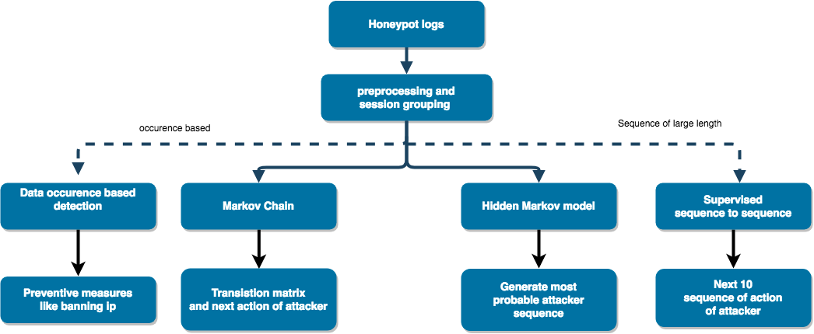
1.3 - Our Initial Approach

Slide 9
1.4 - What is a Honeypot?
A network-attached system set up as a decoy used -
to lure cyber attackers
to detect, deflect or study hacking attempts in order to gain unauthorized access to information systems.
The function of a honeypot is to represent itself as a potential target for attackers -- usually a server or other high-value target -- and to gather information and notify defenders of any attempts to access the honeypot by unauthorized users.

Slide 10
(cont) Cowrie Honeypot Logs
Medium interaction SSH and Telnet honeypot designed to log brute force attacks and the shell interaction performed by the attacker.
Provides a fake filesystem with the ability to add/remove files.
Cowrie saves files downloaded with wget/curl or uploaded with SFTP and scp for later inspection.
Logging of direct-tcp connection attempts (ssh proxying)
Logging in JSON format

Slide 11
(cont) Cowrie Honeypot Logs
{
"eventid": "cowrie.client.version",
"timestamp": "2017-07-03T18:30:08.235671Z",
"session": "577076dfb79e",
"message": "Remote SSH version: SSH-2.0-PUTTY",
"system": "HoneyPotSSHTransport,523,116.31.116.16",
"isError": 0,
"src_ip": "116.31.116.16",
"version": "SSH-2.0-PUTTY",
“dst_ip”: “10.10.0.13”,
"sensor": "DC-NIC-Mumbai",
}

Slide 12
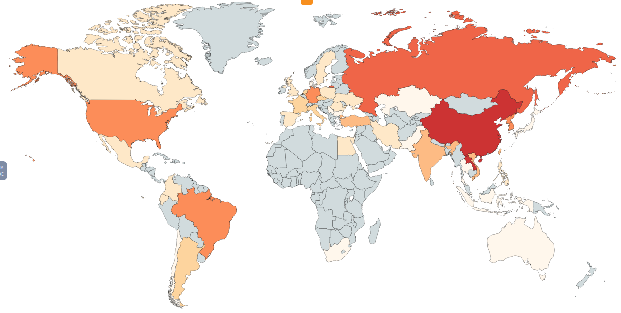
(cont) Cowrie Honeypot Logs

Slide 13
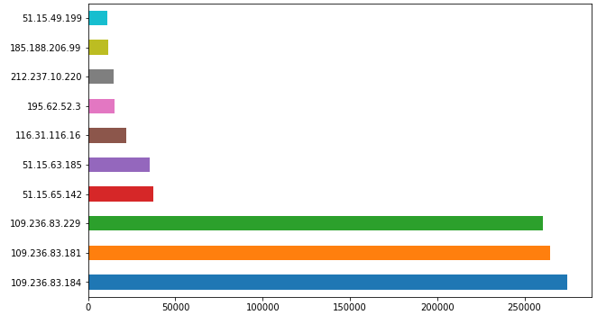
(cont) Cowrie Honeypot Logs
Most common IPs involved in attacks

Slide 14
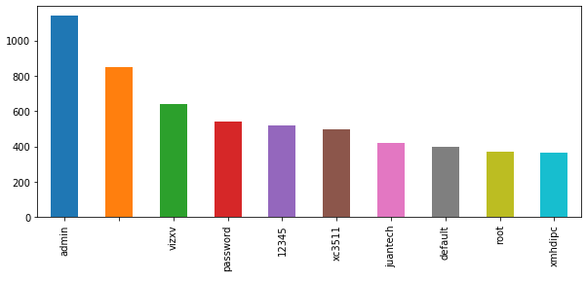
(cont) Cowrie Honeypot Logs
Common passwords used

Slide 15
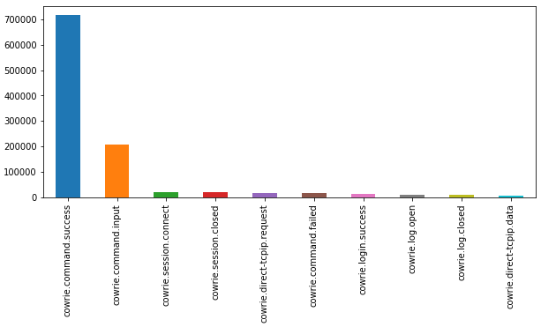
(cont) Cowrie Honeypot Logs
Most occuring events in attack sessions

Slide 16
1.5 - Logs Preprocessing for Modelling
Modelled into 19 states
0: 'cowrie.client.size', 1: 'cowrie.client.version', 2: 'cowrie.command.failed',
3: 'cowrie.command.input/delete', 4: 'cowrie.command.input/dir_sudo',
5: 'cowrie.command.input/other', 6: 'cowrie.command.input/system',
7: 'cowrie.command.input/write', 8: 'cowrie.command.success',
9: 'cowrie.direct-tcpip.data', 10: 'cowrie.direct-tcpip.request', 11:'cowrie.log.closed',
12: 'cowrie.log.open', 13: 'cowrie.login.failed', 14: 'cowrie.login.success',
15: 'cowrie.session.closed', 16: 'cowrie.session.connect',
17:'cowrie.session.file_download', 18: 'cowrie.session.input'

Slide 17
Models Used
Markov Chain
Hidden Markov Models
Generative Sequence Modelling using LSTM

Slide 18
Markov Chain
A Markov chain is a stochastic model describing a sequence of possible events in which the probability of each event depends only on the state attained in the previous event.
P (Xt=x | Xt-1, Xt-2, Xt-3....X1, X0) = P (Xt | Xt-1)
where Xt is the state at instant t

Slide 19
Results - Markov Chain
First order Markov chain modelling 19 different events as 19 possible states forming the state space of the chain.
Investigating the transition probabilities generated by the Markov chain, we produced a propagation graph with 19 nodes and 69 edges with corresponding non-zero transition probabilities.

Slide 20
Results - Accuracy achieved
Markov chain: ~70%

Slide 21
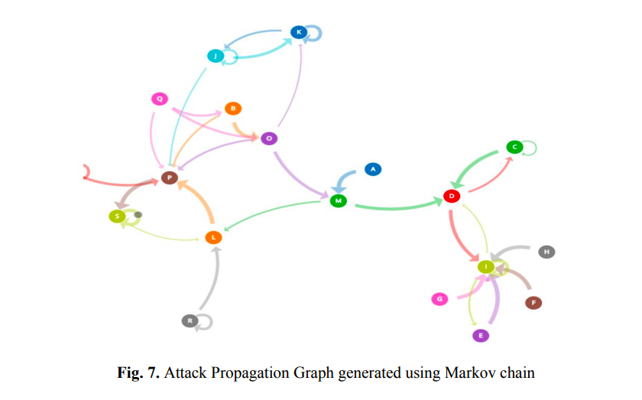

Slide 22
Hidden Markov Model
The hidden markov model is a statistical Markov model in which the system being model is assumed to be a markov process with unobserved hidden states.
Advantages:
Latent variable representation
Unsupervised, Efficient learning algorithm, small data
Variable length

Slide 23
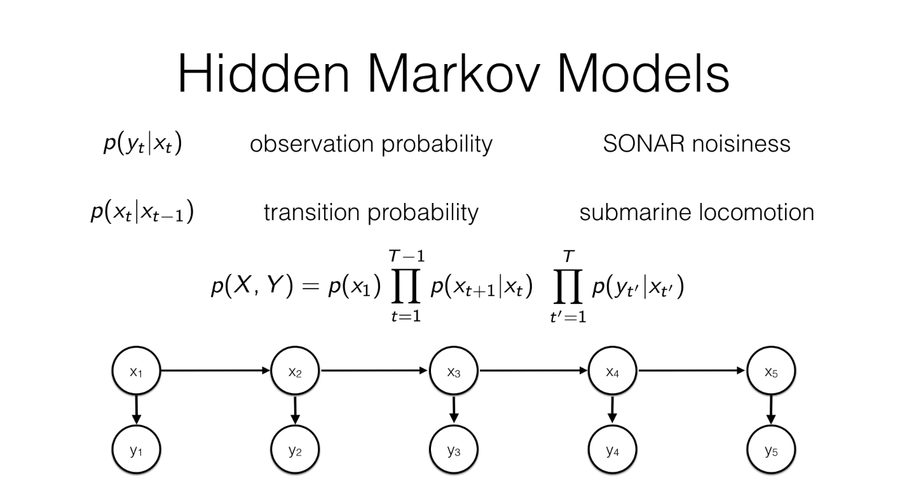

Slide 24
Applying it to model attacker patterns
Modelling Eventid as visible states
19 states formed ranging from login, version check to deleting, copying and insertion of files/malwares
Training HMM on the above discrete state patterns to model behaviour of attacker and predict his future actions

Slide 25
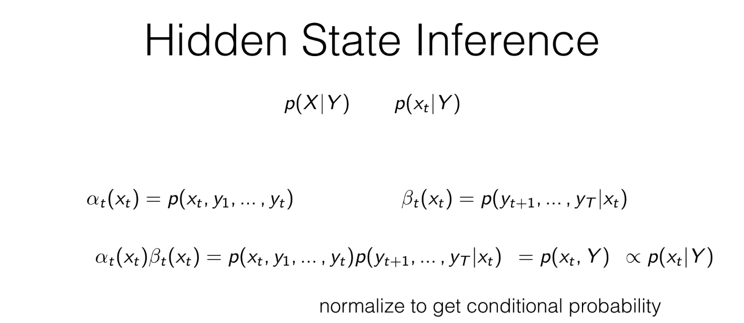

Slide 26
Algorithm for training
It consists of mainly 3 parts per iteration:
Forward pass
Backward pass
Expectation maximization

Slide 27
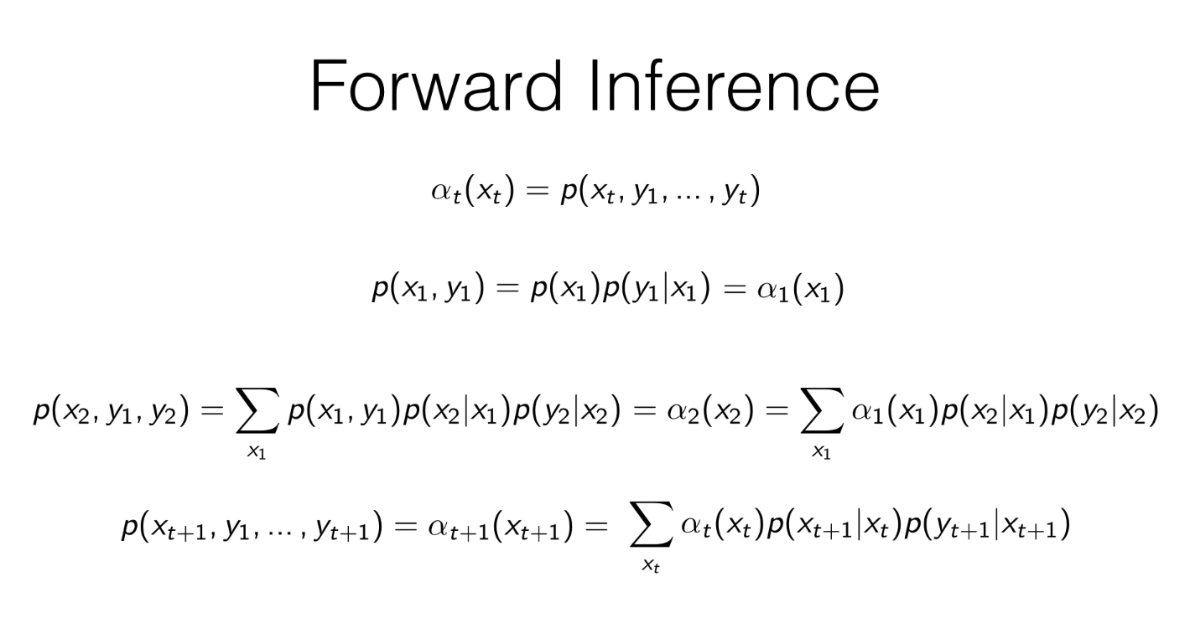

Slide 28
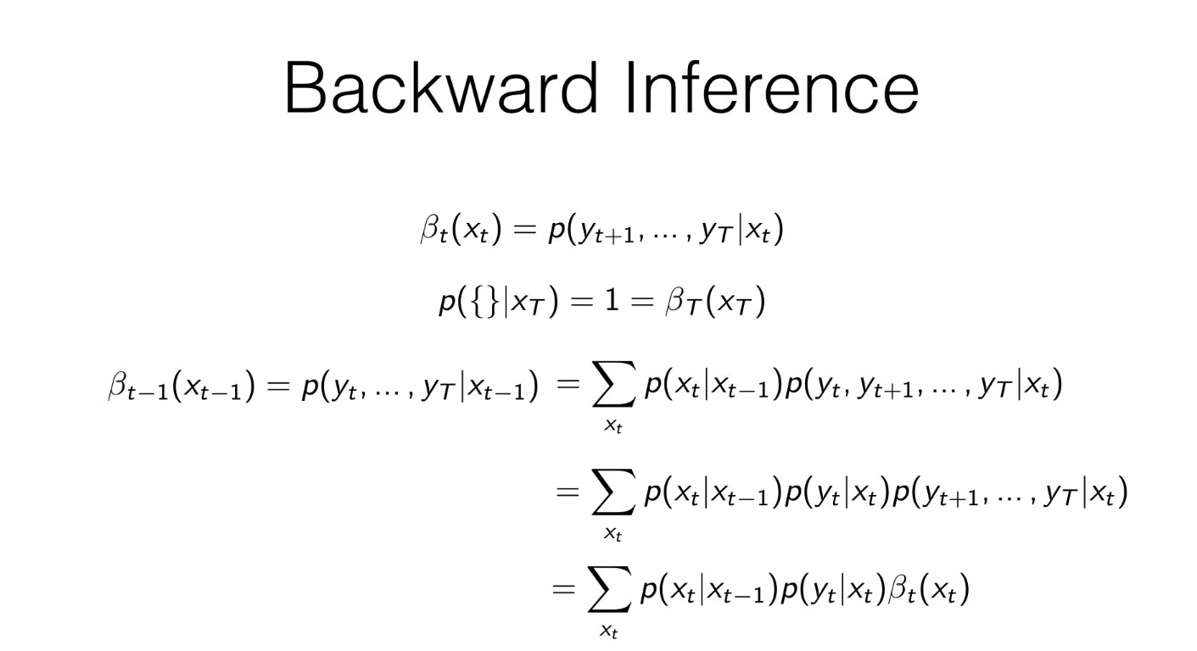

Slide 29
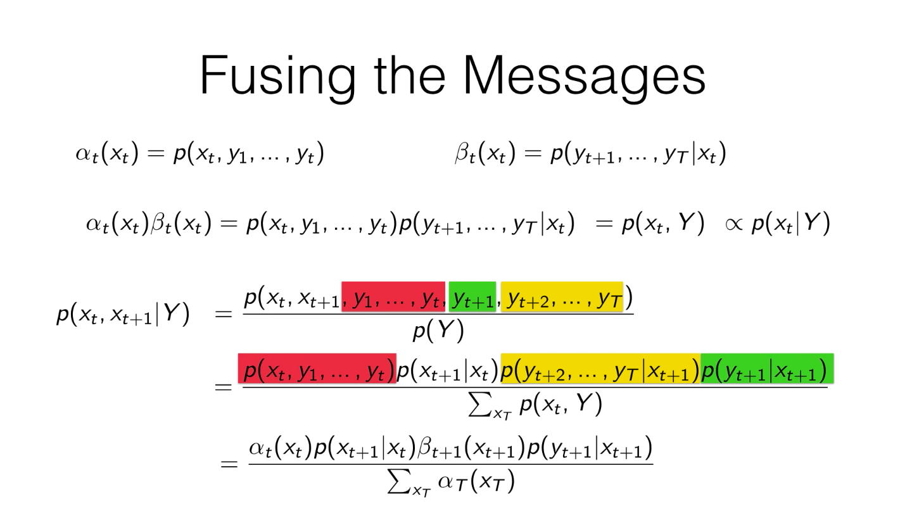

Slide 30
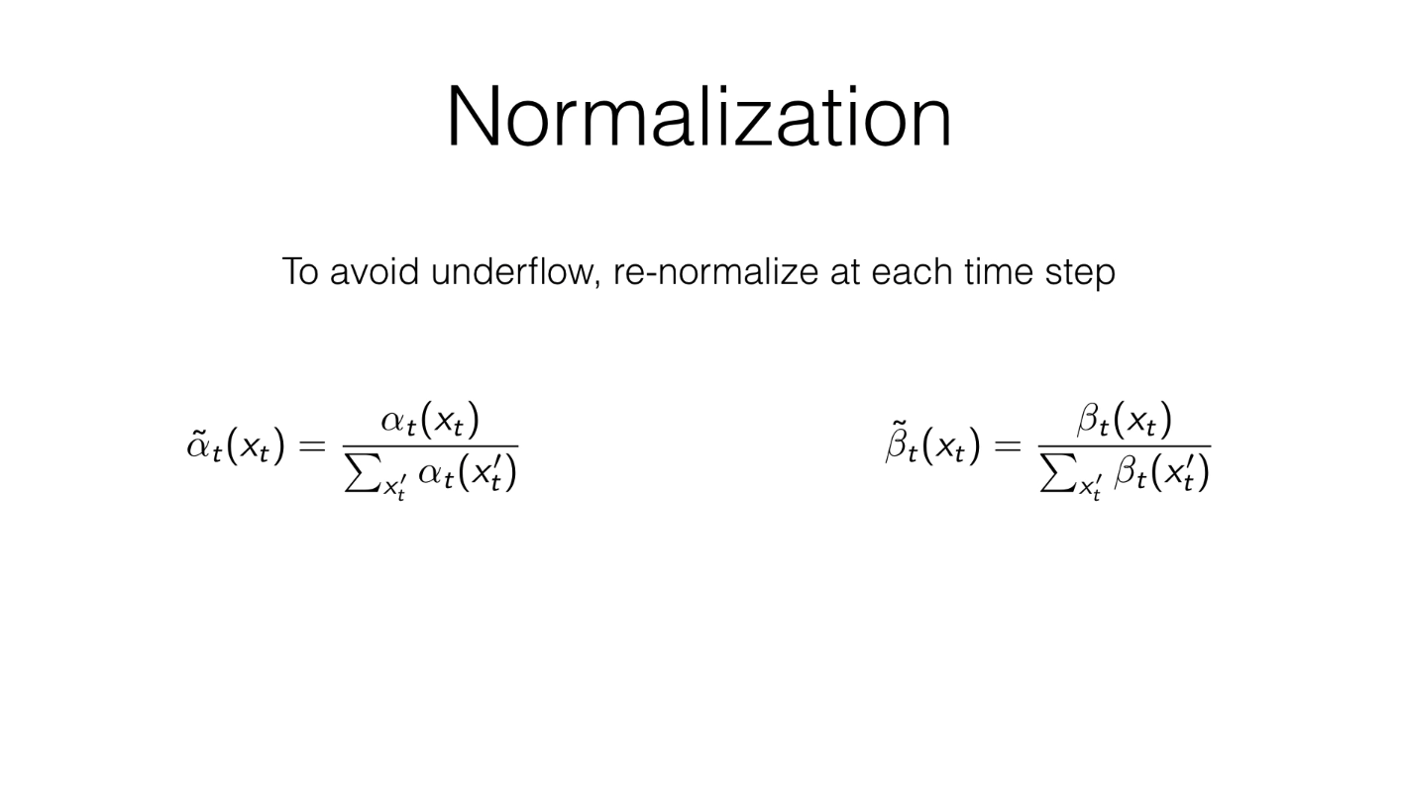

Slide 31
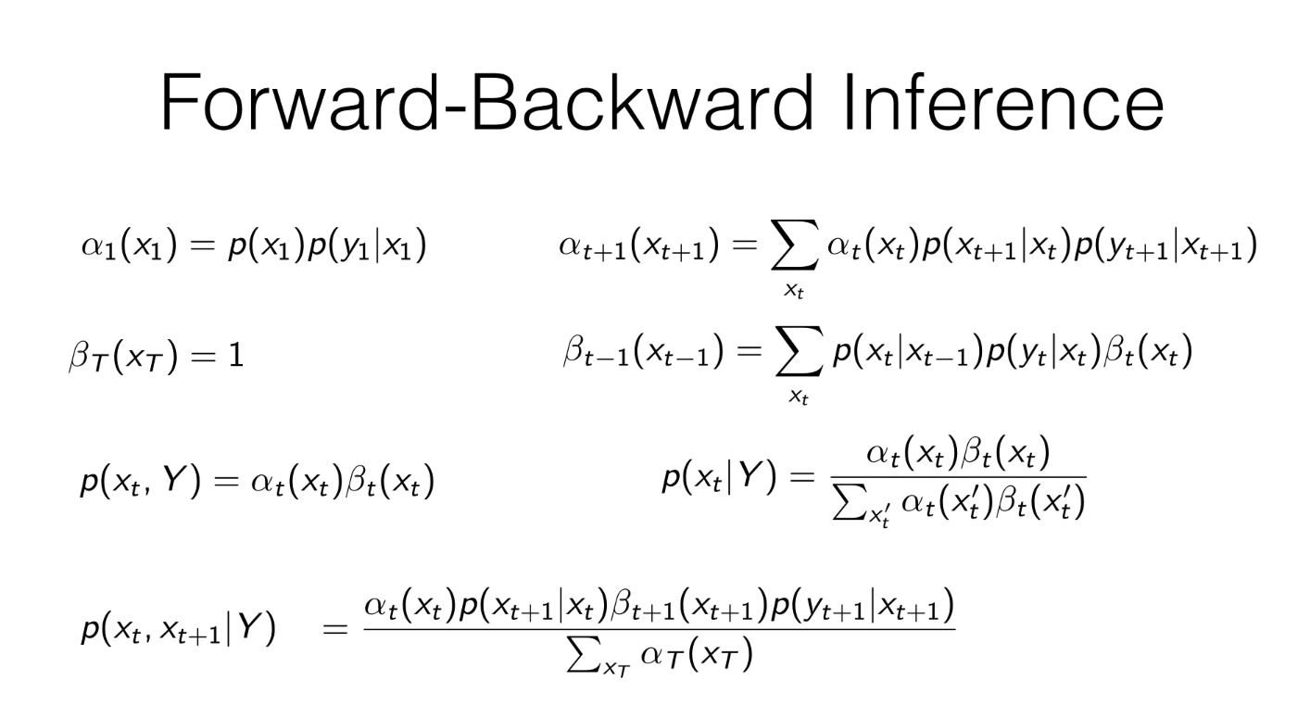

Slide 32
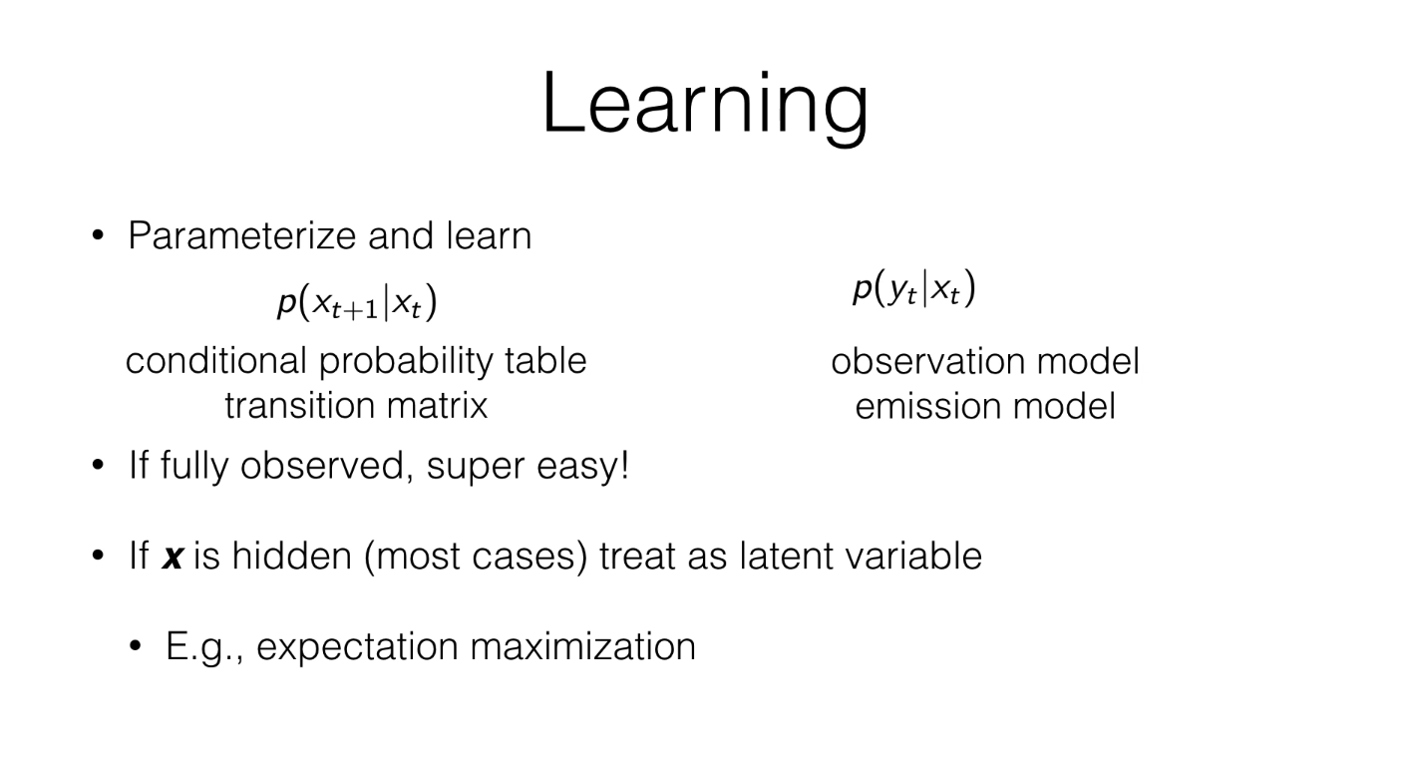

Slide 33
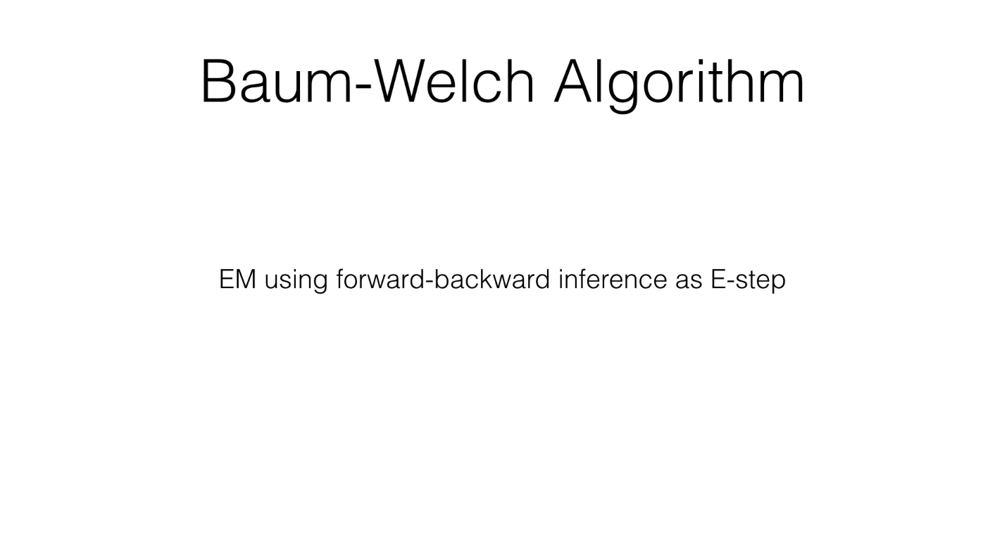

Slide 34
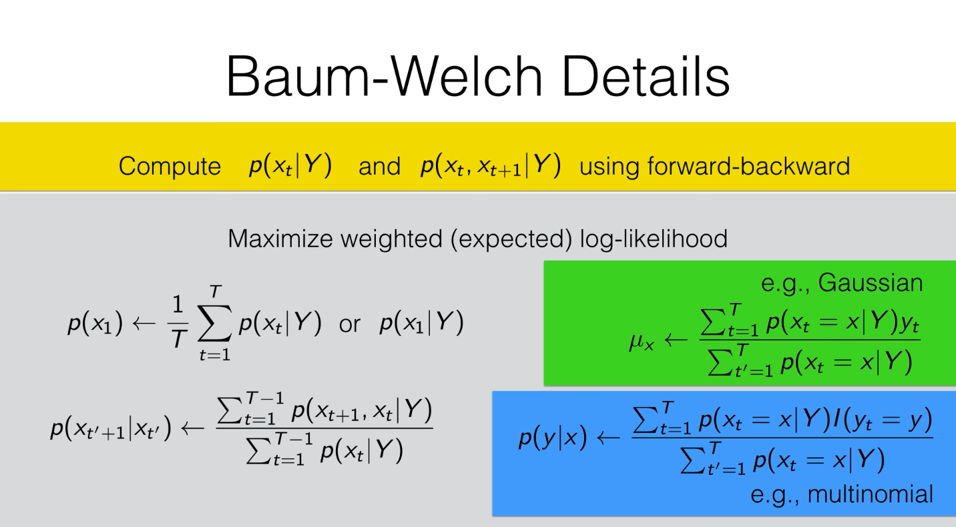

Slide 35
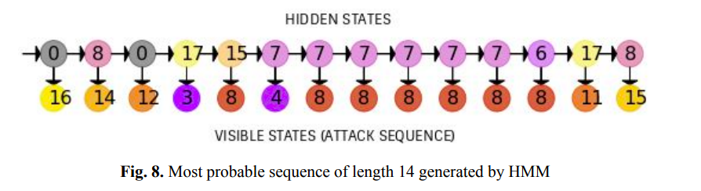

Slide 37
Results - Data Used
Cowrie honeypot logs generated from April 2017 to July 2017 were used.
22,499 distinct attack sessions with attack sessions lasted from 2 steps to over 1400 steps. 30% sessions lasted for more than 20 steps.

Slide 38
Results - Data Used
Cowrie honeypot logs generated from April 2017 to July 2017 were used.
22,499 distinct attack sessions with attack sessions lasted from 2 steps to over 1400 steps. 30% sessions lasted for more than 20 steps.

Slide 39
Results - Accuracy achieved
Hidden Markov Model: 73 - 74%

Slide 40
Results - HMM
Modelling eventid as visible states - 19 states formed ranging from login, version check to deleting, copying and insertion of files/malwares
Better performance than simple Markov chain
Is not biased towards high probability states
Implemented in python with EM algorithm used to train the model

Slide 41
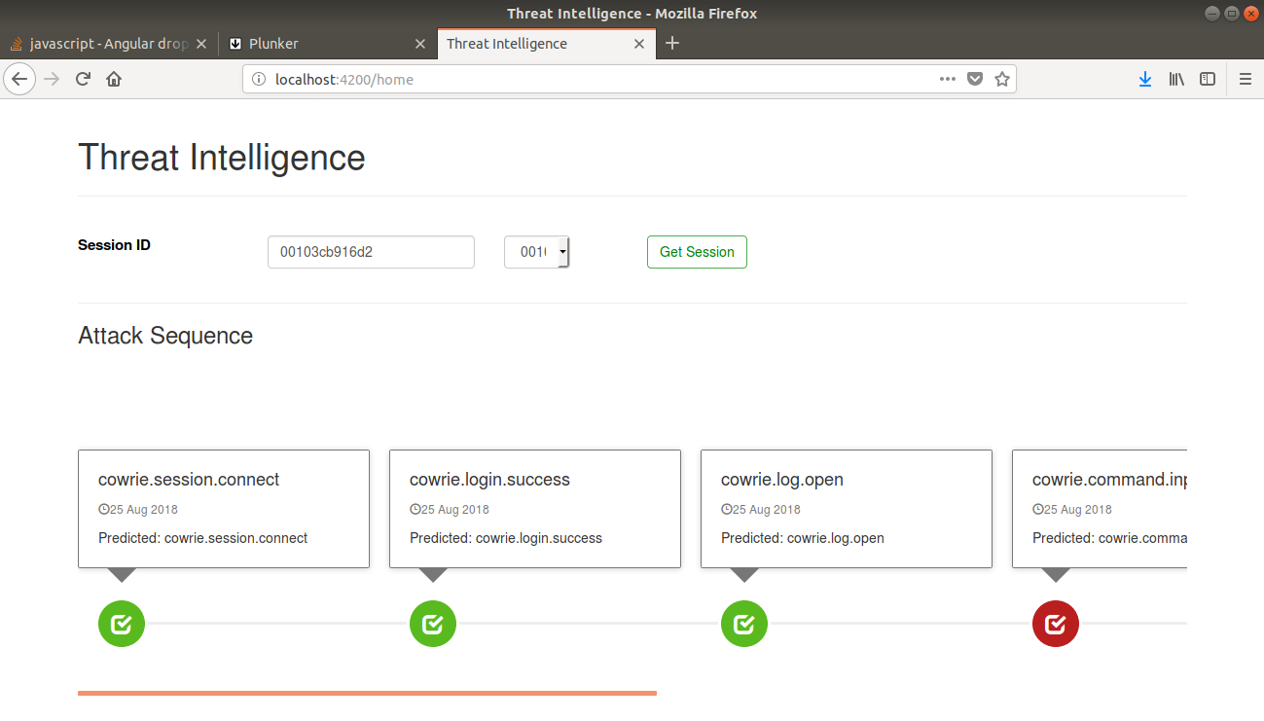

Slide 42
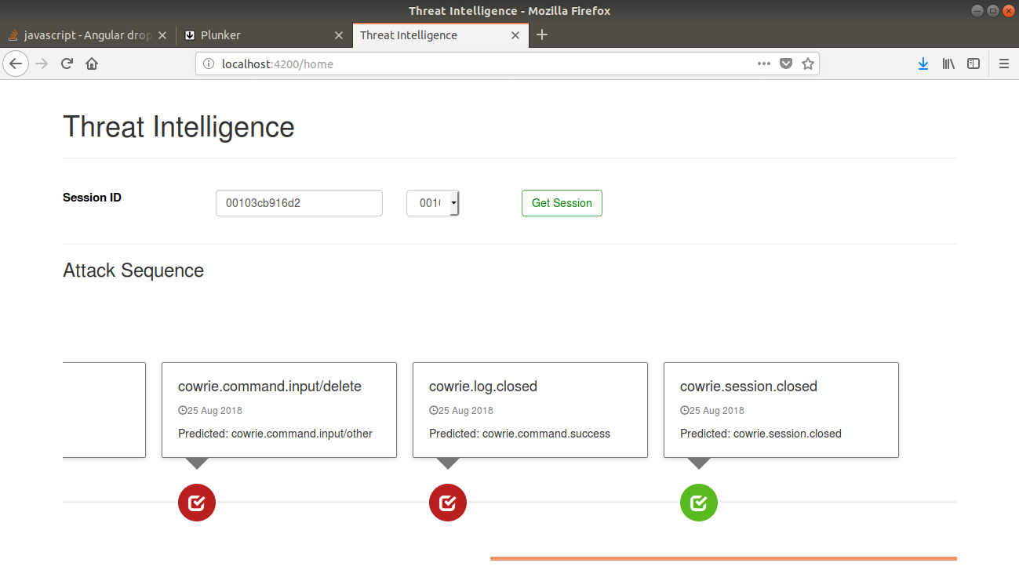

Slide 43
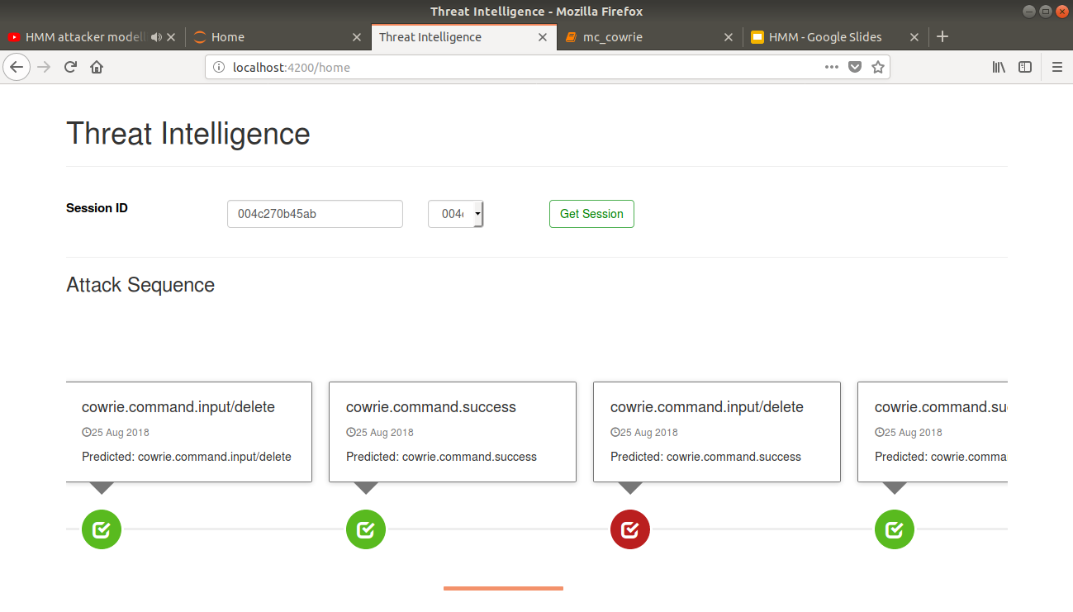

Slide 44
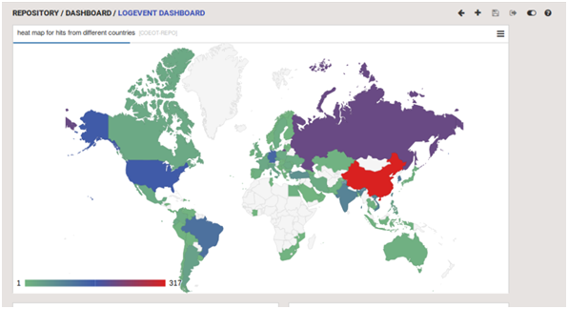
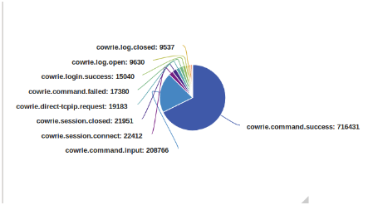
Deployed on DNIF

Slide 45
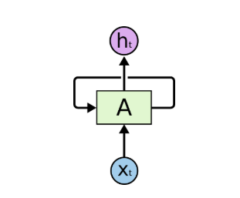
Recurrent Neural Network
Tradition Neural Network treat each input independently
The time dependency is added with Recurrent Neural Network
In the diagram, a chunk of neural network A, looks at some input x_{t} and outputs a value h_{t}. A loop allows information to be passed from one step of the network to the next

Slide 46
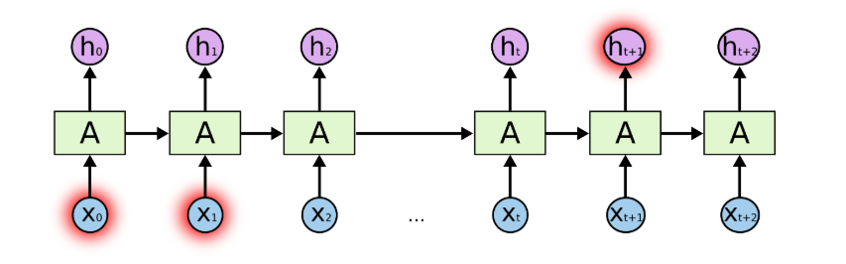
LSTM Network
The information from long term dependencies is lost by the traditional Recurrent Neural Network.
This Vanishing gradient problem is solved by LSTM cells.

Slide 47
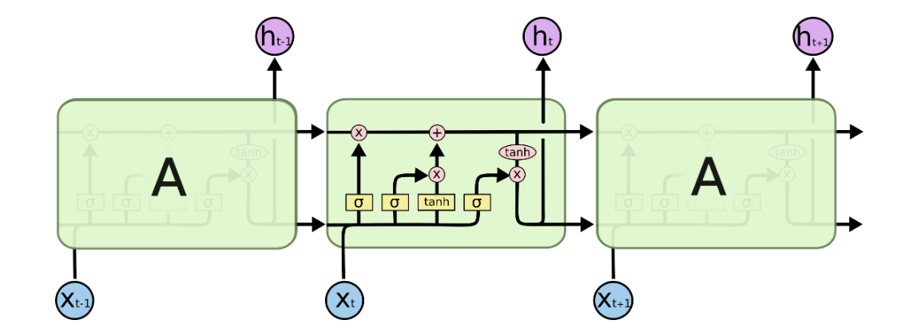
(cont) LSTM Networks

Slide 48
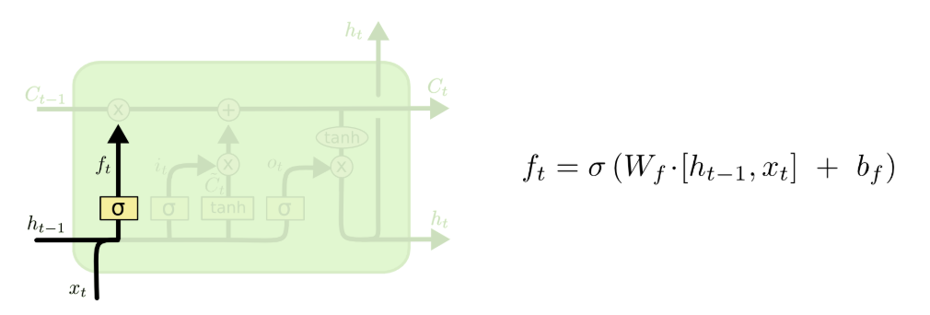
(cont) Forget Gate

Slide 49
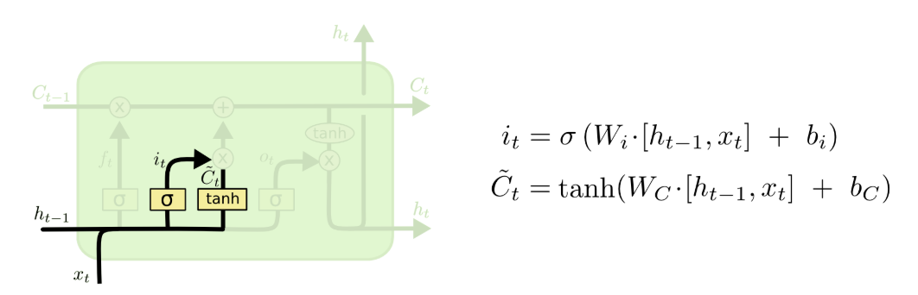
(cont) Input Gate

Slide 50
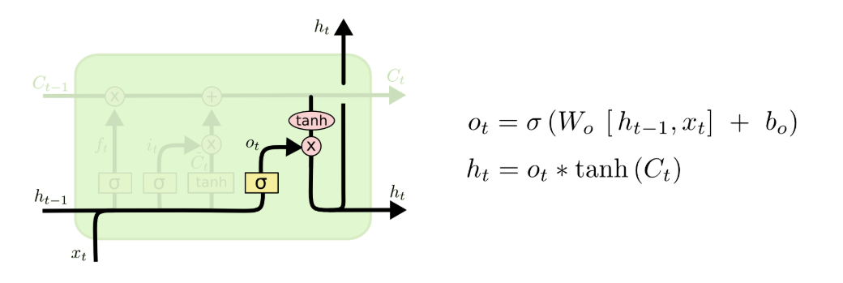
(cont) Output Gate

Slide 51
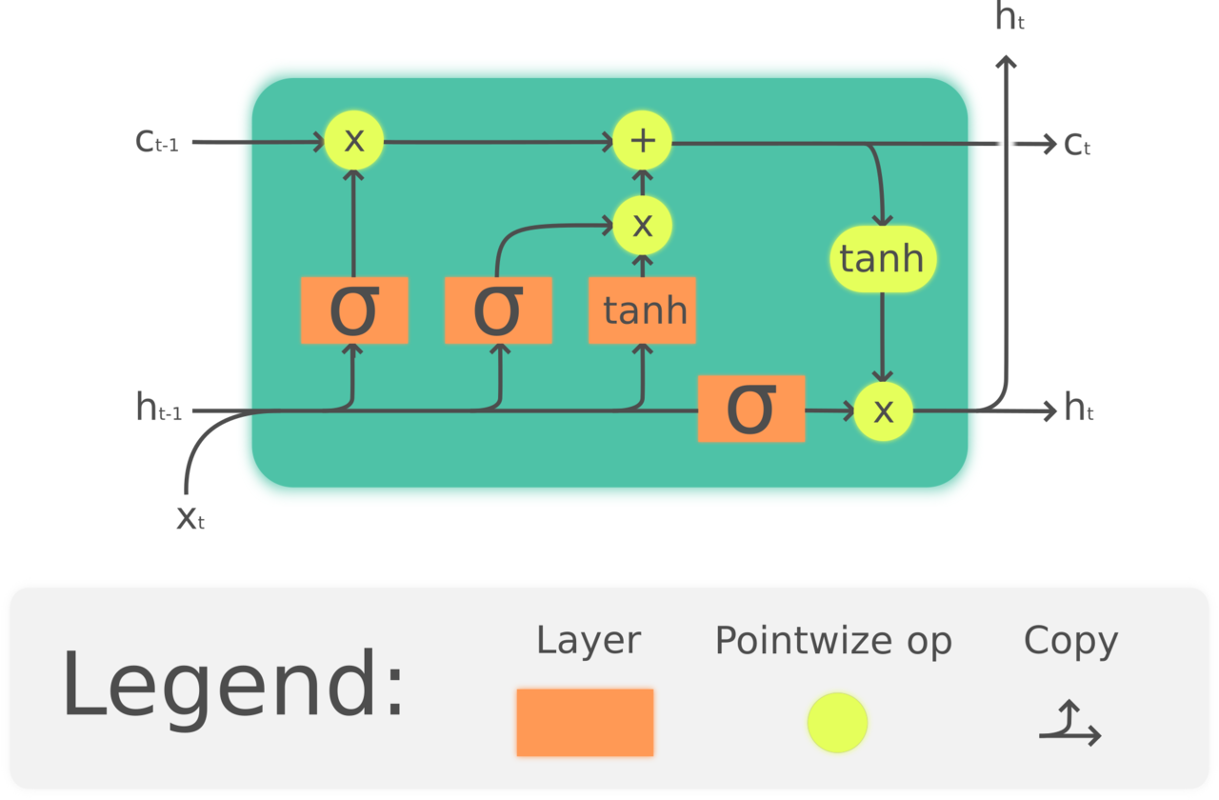
Deep learning - Generative LSTM-based Model
Specifics:
Regression problem, MSE loss
Two layer LSTM network
prediction of future 10 states

Slide 52
Results - Data Used
Cowrie honeypot logs generated from April 2017 to July 2017 were used.
22,499 distinct attack sessions with attack sessions lasted from 2 steps to over 1400 steps. 30% sessions lasted for more than 20 steps.

Slide 53
Results - Accuracy achieved
Markov chain: ~70%
Hidden Markov Model: 73 - 74%
LSTM architecture: 81 - 85%

Slide 54
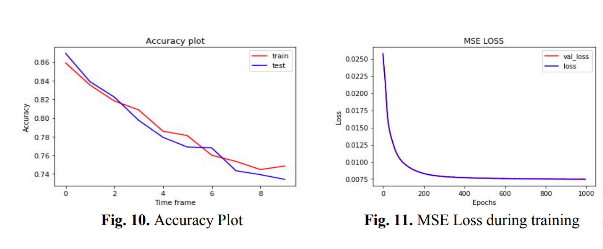
Results - LSTM-based Model

Slide 55
Results - LSTM-based Model
Predicts future 10 states in time with an accuracy ranging from 86 to 74% for 1st event to 10th event
Much better accuracy
Takes much larger time to train

Slide 56
Results - Accuracy achieved
Markov chain: ~70%
Hidden Markov Model: 73 - 74%
LSTM architecture: 81 - 85%

Slide 57
Conclusion: Phase 1
Analysing the sequences generated by the proposed models may shed light on new and evolving techniques which attackers take which intruding into a system
System administrators may take more stringent steps to tackle these emerging threats
Developed algorithms can be used to take retaliatory actions against attacker

Slide 58
Kafka
What is kafka?
Publish/subscribe messaging system
Unit of data within Kafka is called a message
Messages are written into Kafka in batches.
Collection of messages
Batches are typically compressed
Provides for more efficient data transfer and storage

Slide 59
Why Kafka?
Multiple Producers
Multiple Consumers
Disk-based Retention
Scalable
High Performance
Real Time Streaming

Slide 60
Topics and Partitions
Messages in Kafka are categorized into topics.
Topics are additionally broken down into a number of partitions.
No guarantee of time-ordering of messages across the entire topic, just within a single partition.
Partitions are the way that Kafka provides redundancy and scalability.
Partition can be hosted on a different server.
Single topic can be scaled horizontally across multiple servers to provide for performance.

Slide 61
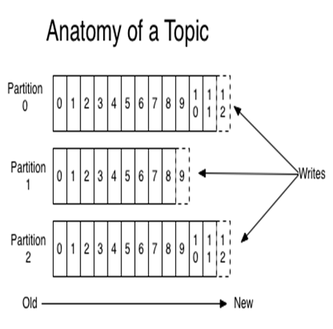
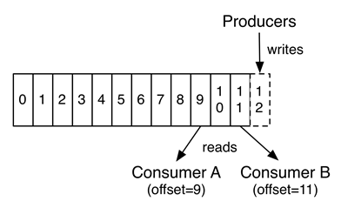

Slide 62
Producers
Producers create new messages.
A message will be produced to a specific topic.
Balance messages over all partitions of a topic evenly
In some cases it will direct messages to specific partitions using the message key and a partitioner
Assures that all messages produced with a given key will get written to the same partition.
Also use a custom partitioner that follows other business rules for mapping messages to partitions.

Slide 63
Consumer
Consumers read messages.
Consumer subscribes to one or more topics and reads the messages in the order they were produced.
Keeps track of which messages it has already consumed by keeping track of the offset
Consumers work as part of a consumer group.
One or more consumers that work together to consume a topic.
Group assures that each partition is only consumed by one member.
In this way, consumers can horizontally scale to consume topics
If a single consumer fails, the remaining members of the group will rebalance the partitions

Slide 64
Brokers and Clusters
A single Kafka server is called a broker.
Receives messages from producers, assigns offsets to them, and commits the messages to storage on disk.
Serves consumers, responding to fetch requests
A single broker can easily handle thousands of partitions and millions of messages per second.
Designed to operate as part of a cluster.
One will also function as the cluster controller
Controller is responsible for administrative operations, including assigning partitions to brokers and monitoring for broker failures.

Slide 65
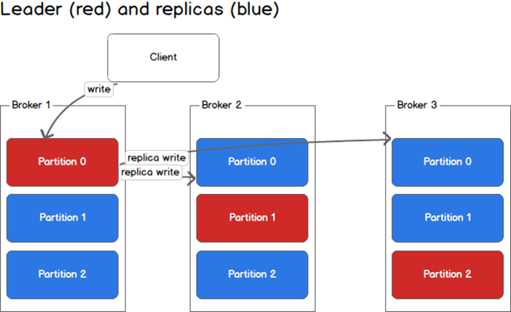

Slide 66
Kafka Stream
Client library for building applications and microservices
Input and output data are stored in a Apache Kafka
Two special processors in the topology:
Source Processor:
Produces an input stream to its topology from one or multiple Kafka topics
Sink Processor:
Sends any received records from its up-stream processors to a specified Kafka topic.

Slide 67
Data Structures
Operations
KStream
KTable
Map
Reduce

Slide 68
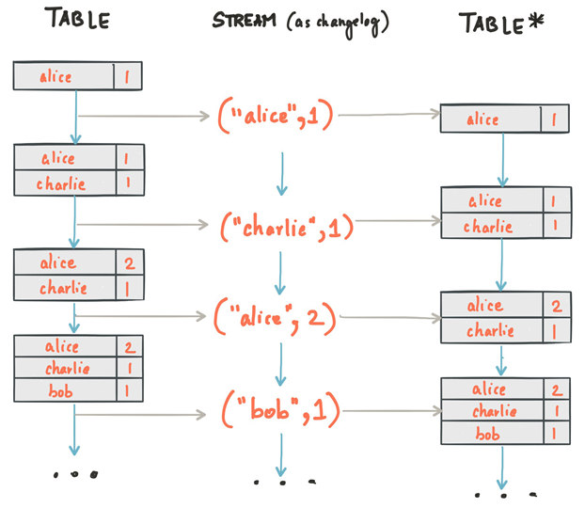

Slide 69
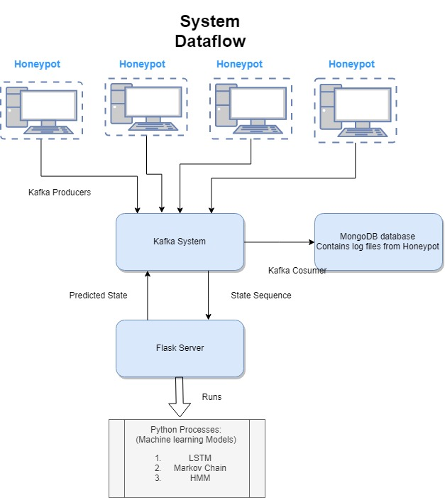
Overall System Workflow
The system Components are:
Cowrie Honeypot
Kafka System
Machine learning Models
MongoDB system

Slide 70
Dataflow of system
Cowrie Honeypot:
The cowrie honeypot is set up on a computer which is used to lure attacker
The interaction of the attacker is stored in terms of logs
Each session will be logged which will contain the information regarding session_id, event_id
The data will be stored in JSON format and the events are grouped by the session id

Slide 71
Dataflow of system
Kafka Subsystem (Producer):
Each honeypot device has its own producer module.
The producer is responsible for publishing the honeypot log data to the brokers. Each producer node subscribes to a cluster of Kafka brokers which automatically distributes the load among themselves.
The producer constantly monitors the log produced by honeypot device, converts it to JSON format acceptable to the streamer and publishes it to an input topic

Slide 72
Dataflow of system
Kafka Subsystem (Streamer):
Kafka Streamer performs a set of map and reduce operations to aggregate and compute the results.
The first map operation maps the input stream of data into a numeric value and stores the result in a custom data structure named as streamList.
A groupByKey() operation, then aggregates the mapped values with respect to the session Id.
A reduce operation combines the data of each group and produces an intermediate output.in the form of KTable.

Slide 73
Dataflow of system
Kafka Subsystem (Streamer):
Second map phase to produces a stream of predicted output.
The streamer sends a POST request to the flask server.
The server computes the prediction and sends the predicted output back to the streamer.
This map phase produces data in the form of a KStream.
This KStream data is flushed back to the kafka broker via an output topic.

Slide 74
Dataflow of system
Machine learning models:
The Kafka streamer passes the attacker sequence to the Flask server in JSON format using POST request.
The Flask server runs machine learning models which are written in Python language
The LSTM, Markov Chain and LSTM models are used for the prediction and analysis
The predicted sequences are concatenated into an array and passed back to the Kafka System in JSON format

Slide 75
Dataflow of system
MongoDB database:
The MongoDB database is used to store the logs
The dataset contains fields such as event_id, source_ip, destination_ip
The logs can be used to retrain the model to improve the accuracy of the model

Slide 76
User Interface

Slide 77
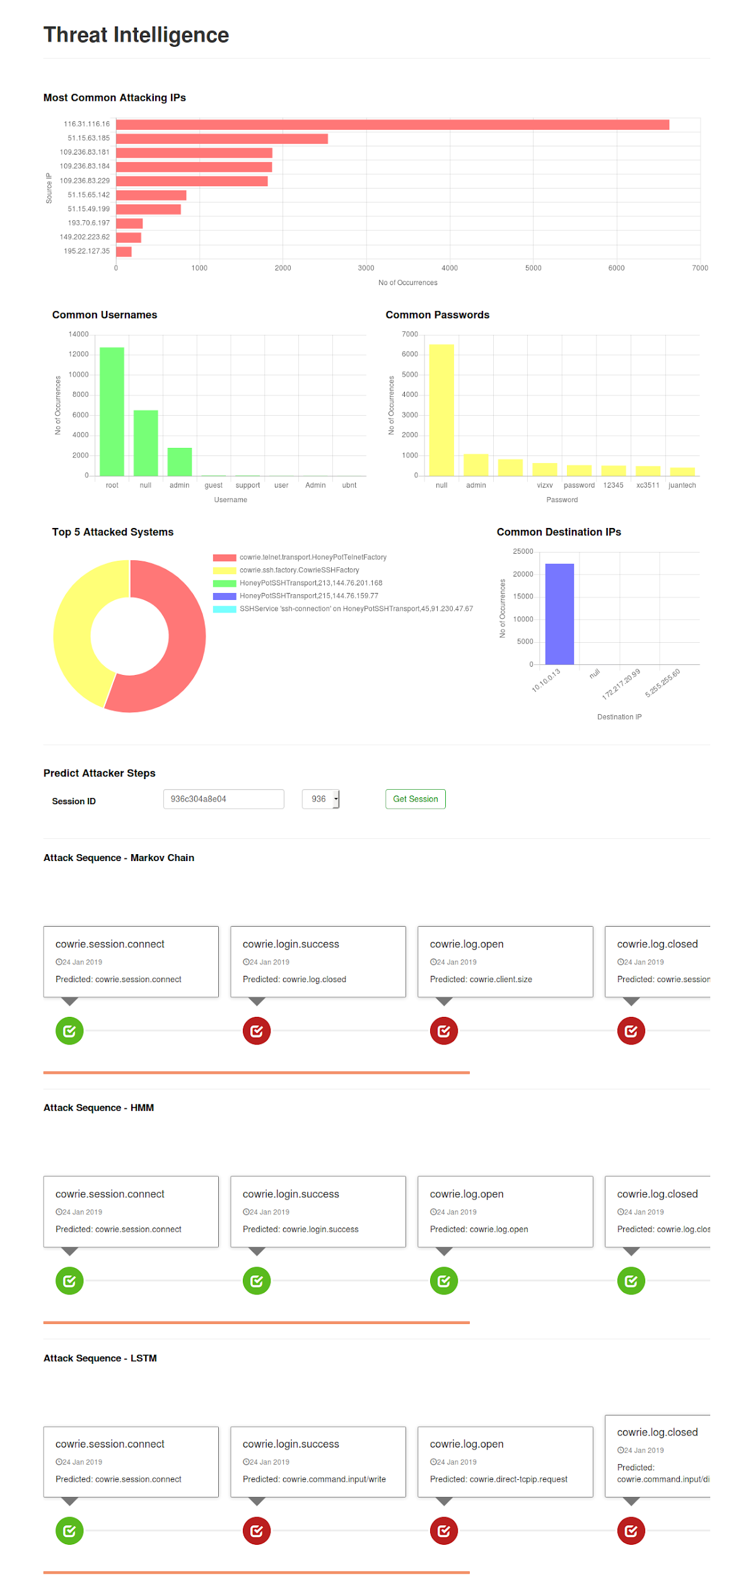

Slide 79
Future Work
Automated action
Improving decision boundary
Efficiency
Reinforcement learning
Using RL, the agent can learn to take retaliatory actions to keep the hacker trapped in honeypot and generate more logs
General Adversarial networks
Using General adversarial networks to deceive and hence improve the existing model
Cython
Training on massive logs is not efficient and can be improved by porting to Cython from Python

Slide 80
Thank you!

